Slide 1



Cover Page
Monday, 01 Dec 2025
PROJ703/ PROJ903 International Challenge Project “Eurobot”
By
ROBO-UN

Slide 2
PROGRESS REPORT
What we have done:
Simulation: Navigation node, debugging lidar issues
Design: Redesign the Model for based on last class feedback and for fabrication purpose
BOM: Updated the BOM
Circuit Diagram : Selecting of right software
Page - 02

Slide 3
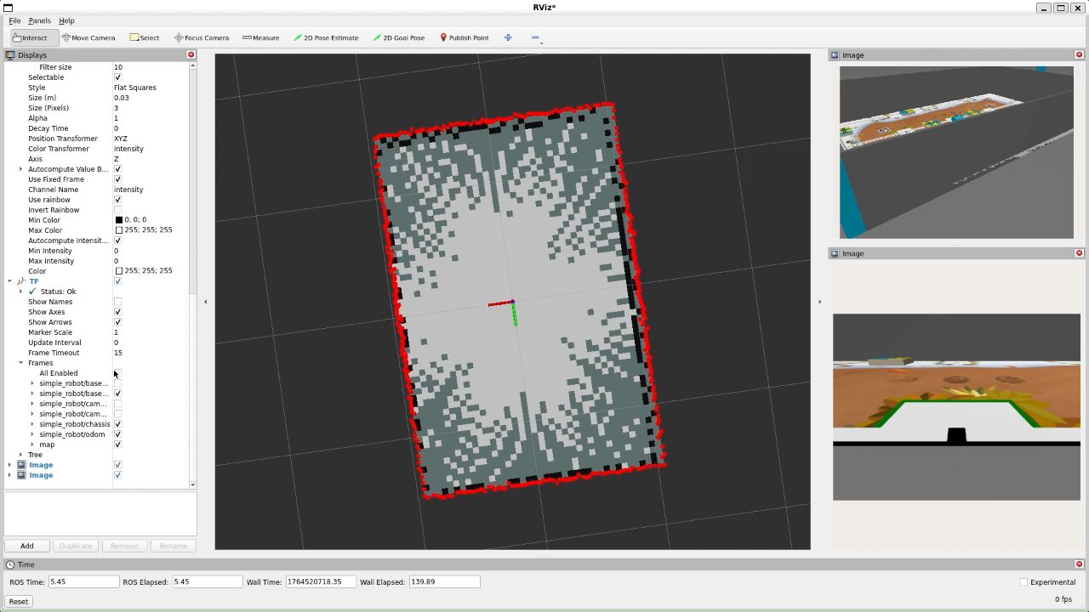
SIMULATION:
Page - 03

Slide 4
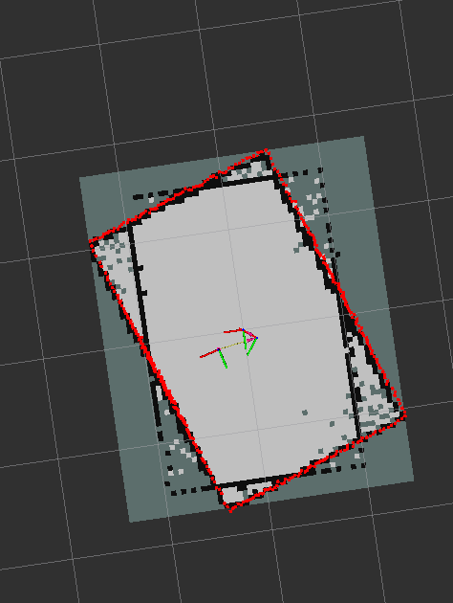
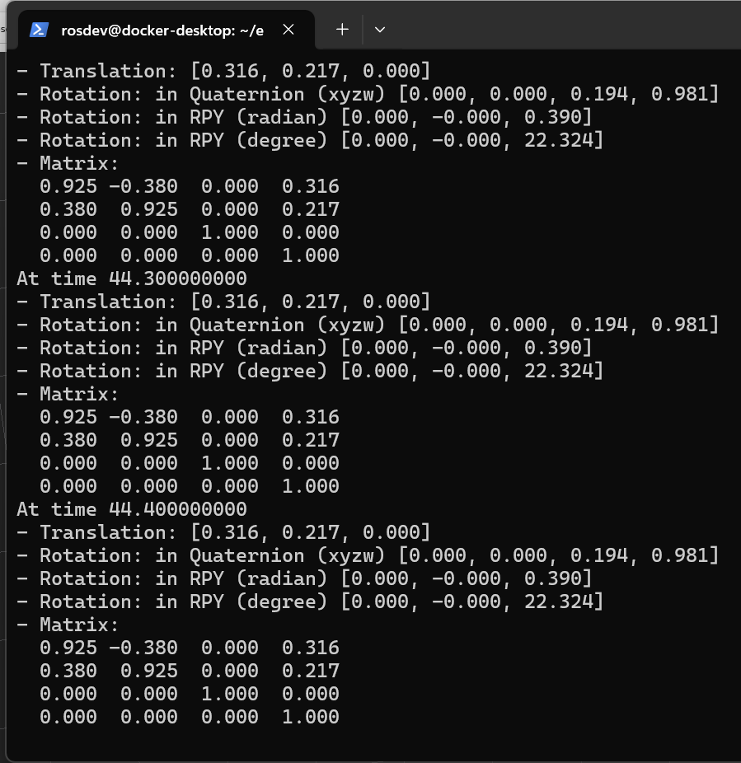
SIMULATION
Page - 04

Slide 5
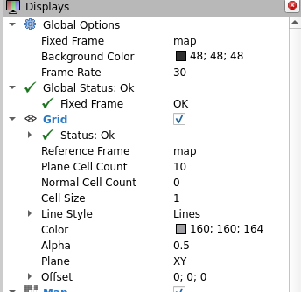
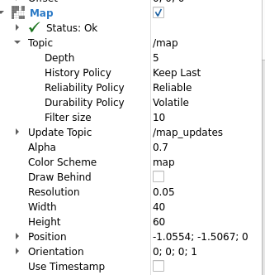
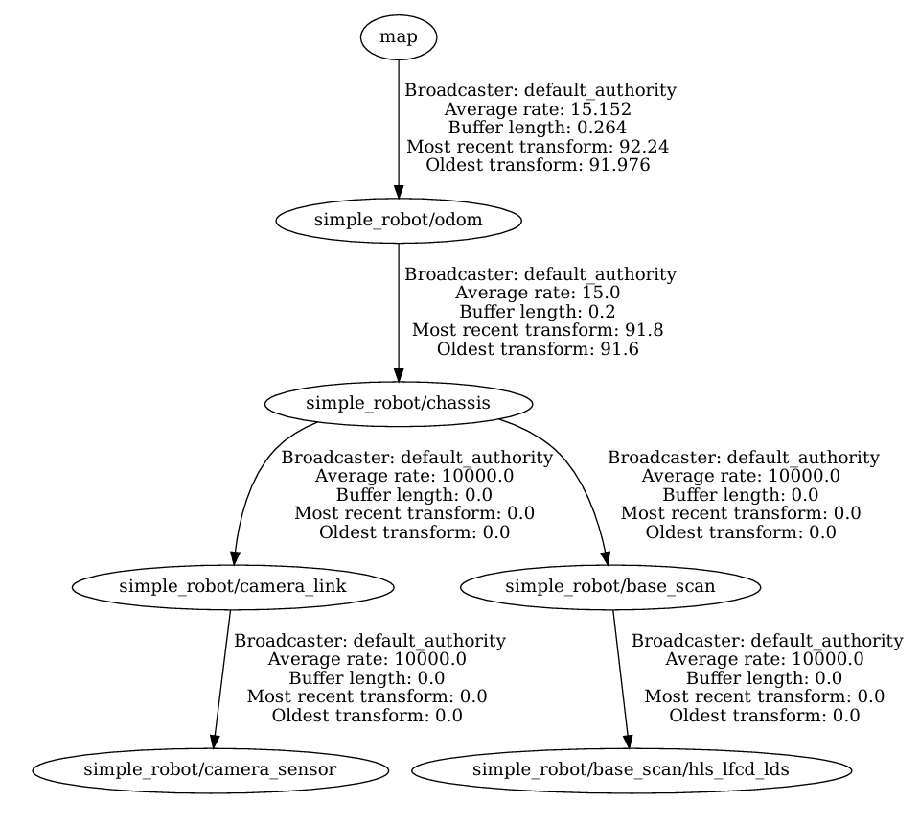
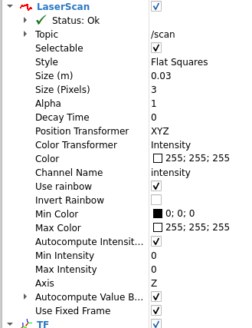
SIMULATION
Page - 05

Slide 6
PROGRAMMING
Background work:
Pushing useful code to github
New documentation
Page - 06

Slide 7
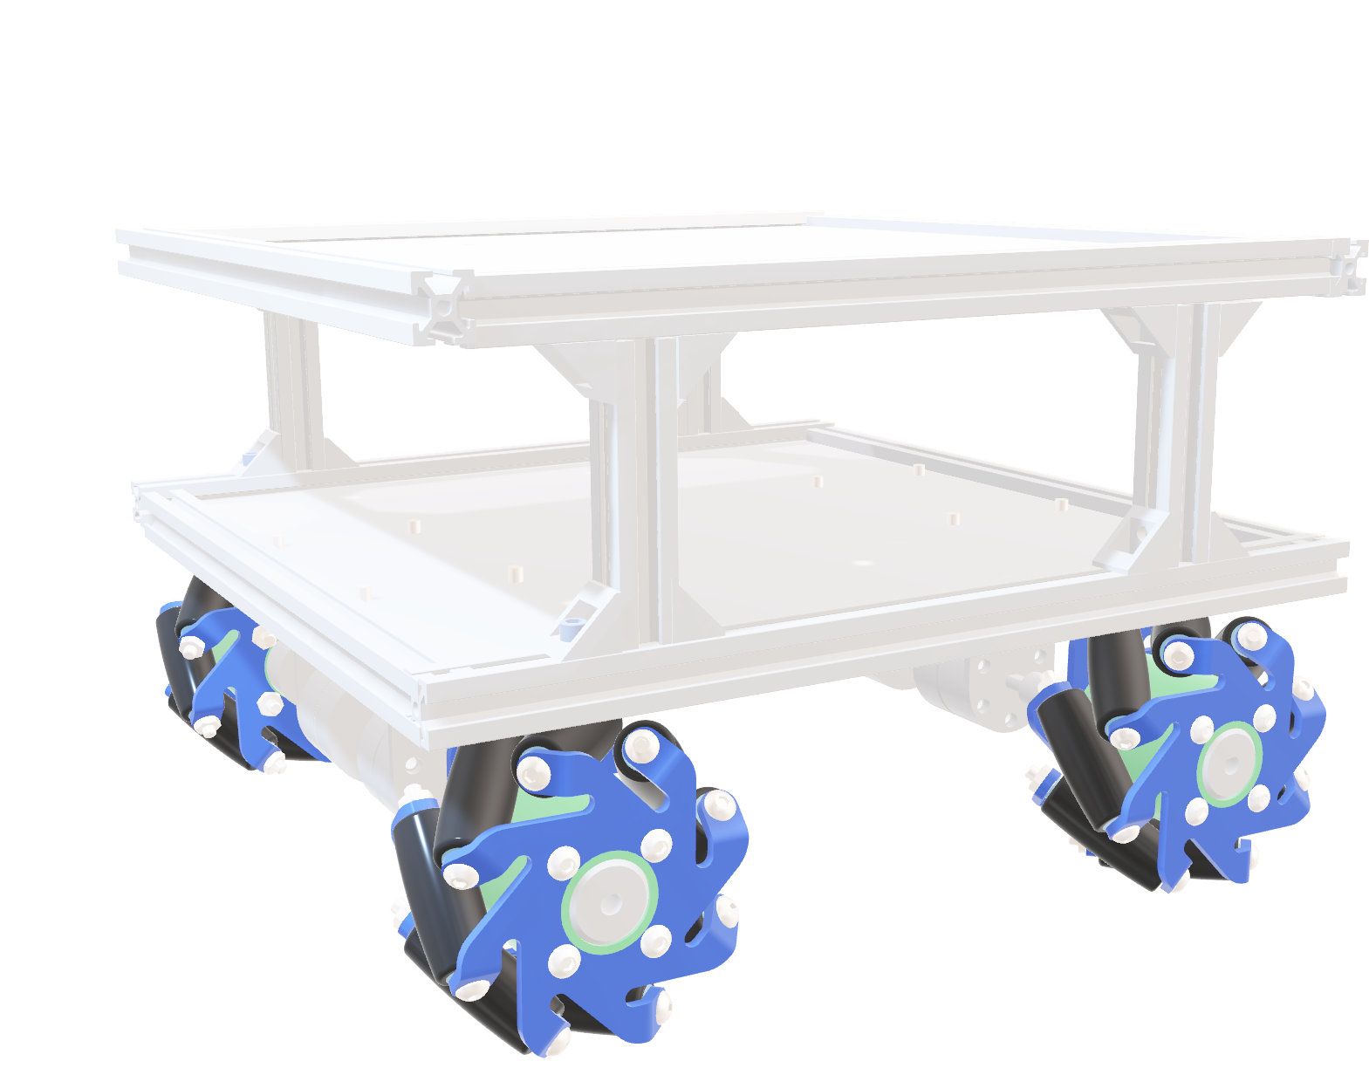
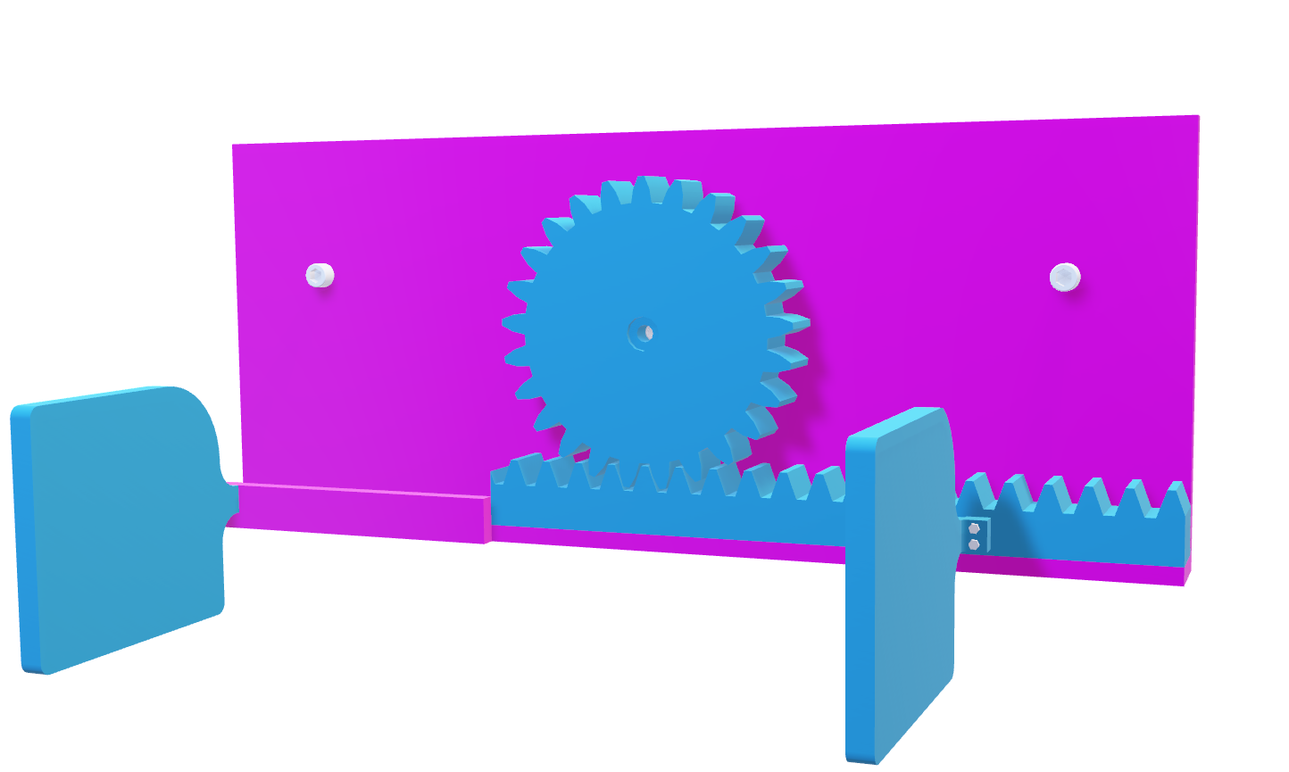
CAD Modelling
Redesign the Model:
Creating multiple parts
Updated the Robot case
Align with the game rules
Page - 07

Slide 8
Electronic Simulation and Circuit Design
•Exploring Multiple Online tools for the Simulations: Fritzing, EasyEDA, WOKWI, Circuito.io.
• Don’t find the desire components.
•Finding the solution to integrate our desire components.
Page - 08

Slide 9
CONCLUSION
What we must do for next session:
Simulation: Finalize localization node
Design: Robot Body(case), Assembly.
Programming: Crate coordinates node
Electronics: Update on Circuit Diagram
Page - 09

